Slide 1

Reinforcement Learning Atari Game: Enduro Racing
Neelima Rajawat
(Group 1)

Slide 2
Getting to Know Reinforcement Learning
Definition:
RL, originating in the 1980s, combines insights from various academic disciplines.
Key Components:
Agent, Environment, State, Rewards, Policy, Values.
Distinctive for its departure from conventional supervised and unsupervised learning methods.
RL embodies a trial-and-error learning approach within interactive environments.

Slide 3
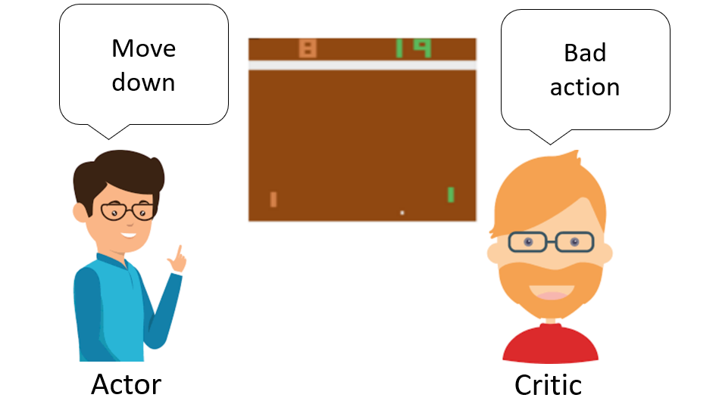
Actor-Critic Methods in Reinforcement Learning
Actor: Responsible for action selection.
Critic: Assesses chosen actions.
Value-Based Methods:
Estimate action or state values, often implemented through Deep Neural Networks.
Policy-Based Methods:
Directly learn optimal policies.
Our Project:
Implementation of the Actor-Critic approach in the context of the Enduro Atari game.
Model refinement through policy gradient (actor) and value function (critic) updates.

Slide 4
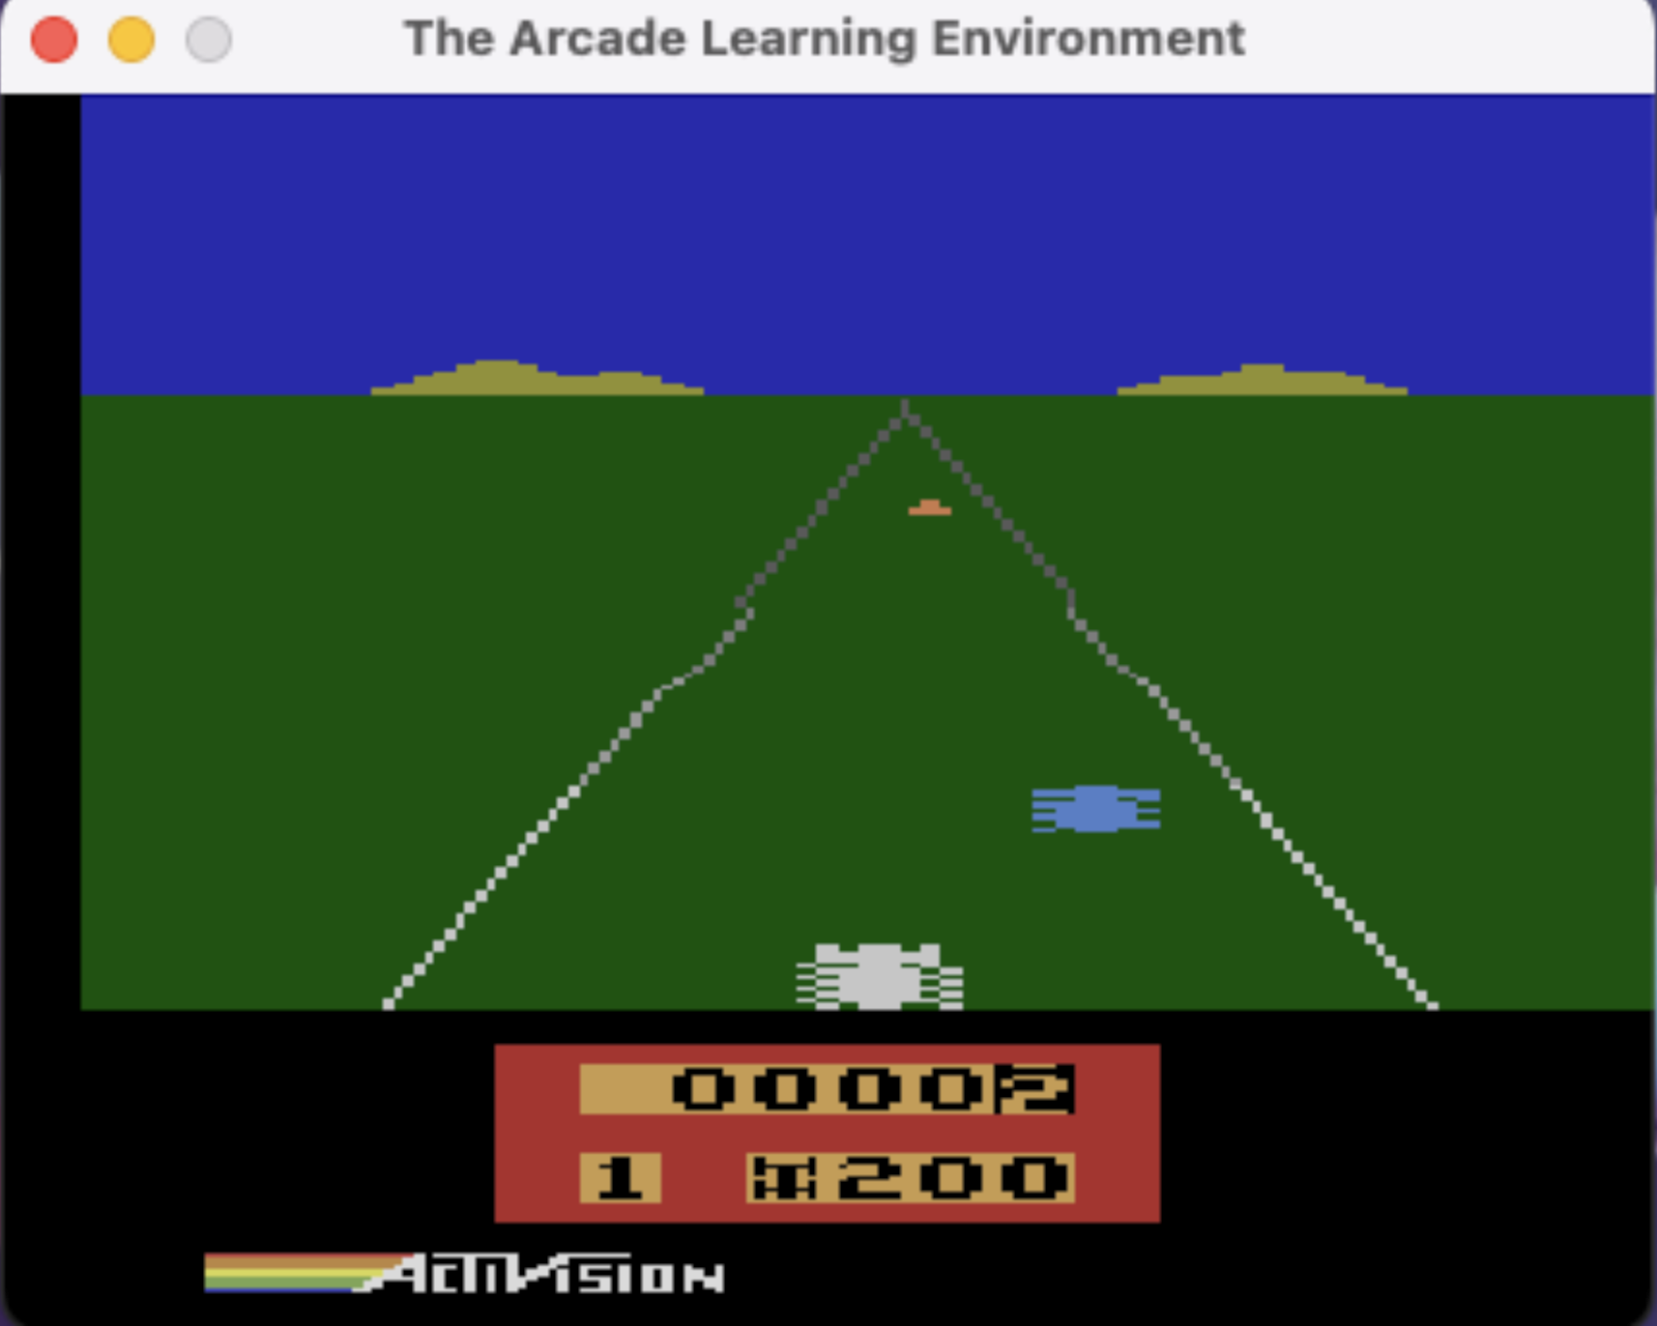
Problem Formulation - Enduro Atari Game
Crafting an agent adept at navigating the intricacies of the Atari game, Enduro—a racing simulation featuring the task of overtaking cars.
Objective:
Optimize the agent's performance, measured through the maximization of the game reward system.
Reward Structure:
Commencing with an initial reward of zero, the agent gains a reward of +1 for successfully overtaking a car and incurs a penalty of -1 for being overtaken.
Time Component:
Embedded within the gameplay is a temporal dimension, with the agent required to surpass a quota of 200 cars initially, then 300 cars per day (terminal state at nightfall).
State Representation:
The agent's state transitions from the initiation at dawn to the conclusion at dusk, contingent upon the fulfillment of passing 200 or 300 cars.

Slide 5
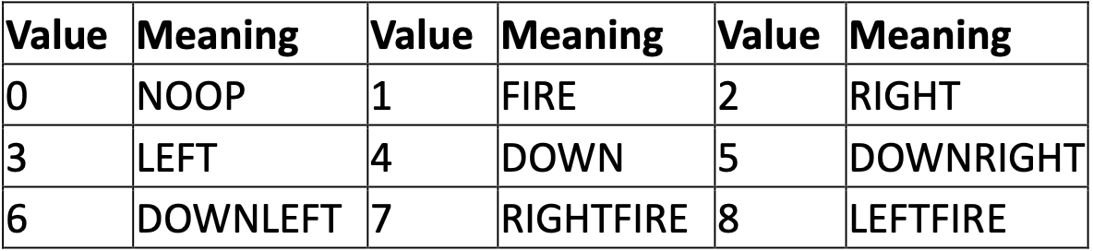
Actions and Gameplay in Atari Enduro
Strategic Considerations:
The agent (player) must wisely select actions to navigate the racing environment effectively.
Performance Evaluation:
The efficacy of the agent is rigorously assessed by scrutinizing the historical record of rewards accrued throughout gameplay.
Challenges:
Risk vs. reward equilibrium, as each action is consequential to the overarching reward structure.
The temporal component adds an additional layer of complexity, demanding good decision-making to meet daily objectives.
Agent (player) actions:

Slide 6
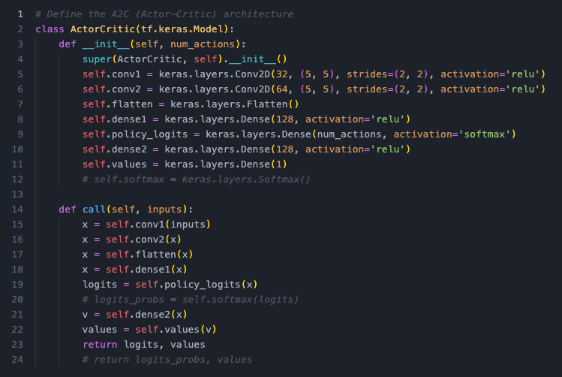
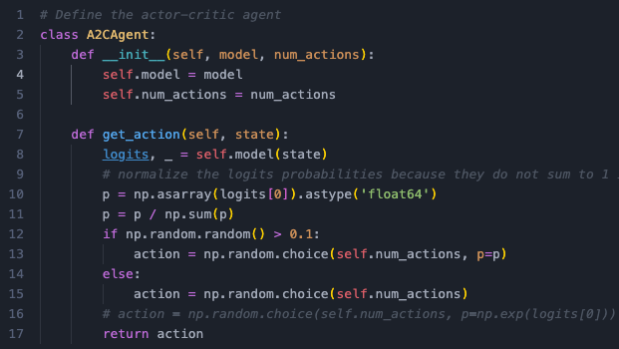
Method design
Objective:
Minimize total loss by combining Actor and Critic Loss.
Advantage is a key metric: R + γV(s′) - V(s).
Network Architecture:
Input: Game screen images.
Actor-Critic Network:
Convolutional Layers: 32 and 64 filters.
Dense Layers: 128 neurons, Softmax for policy, 1 neuron for output

Slide 7
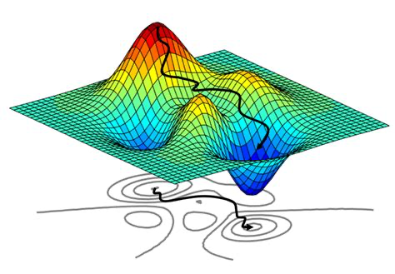
Learning Process and Optimization
Learning Process:
Initialization: Random weights for Actor and Critic.
Training Loop: 60 episodes, collecting state, action, reward, and next state data.
Actor Update: Calculated using policy logits, selected action, and advantage.
Critic Update: Mean squared value of advantage.
Optimization:
Gradients computed using gradient descent.
Adam optimizer updates model weights.
Output:
Model outputs reward values.

Slide 8
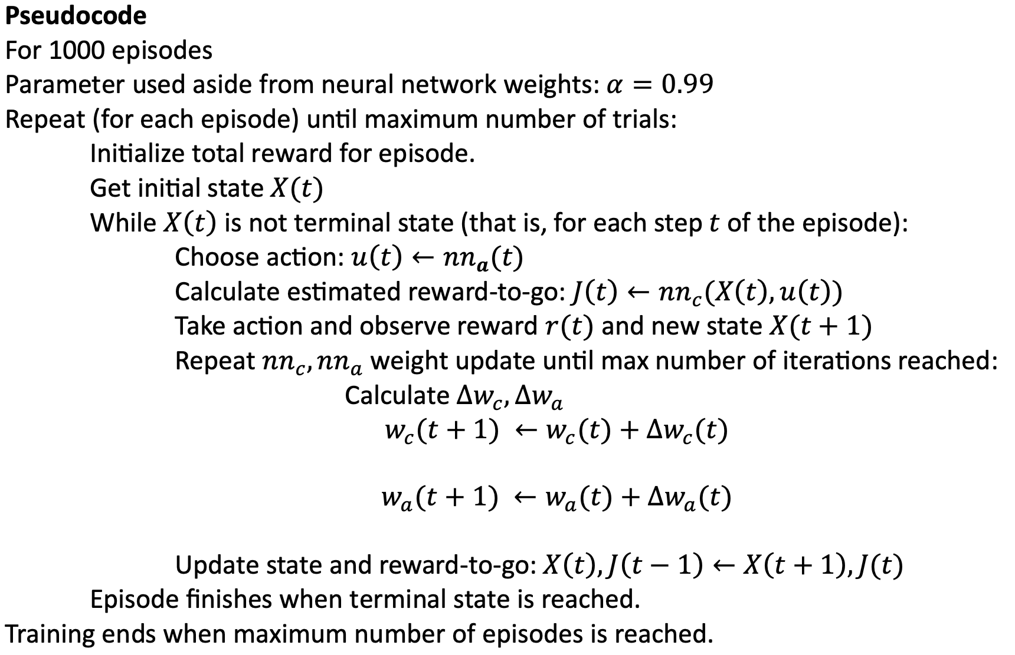
Agent Training IN action
Goal:
Teach the agent to play Enduro by having it interact with the game.
Training Setup:
X rounds of play per training session.
Agent starts either at the game's beginning or the first day.
Each move by the agent updates its learning.
What Happens:
Agent makes moves, sees new game situations, and gets rewards.
Our learning model (Actor-Critic) adjusts itself during every step.
Data Collection:
As long as the game is ongoing, the agent decides its next move.
Each move and its result (state, reward) are recorded.
We keep track of the total rewards earned in each round.
Experiment Design:
We repeat this process for a robust learning experience.
The Actor-Critic model is continually fine-tuned during the training

Slide 9
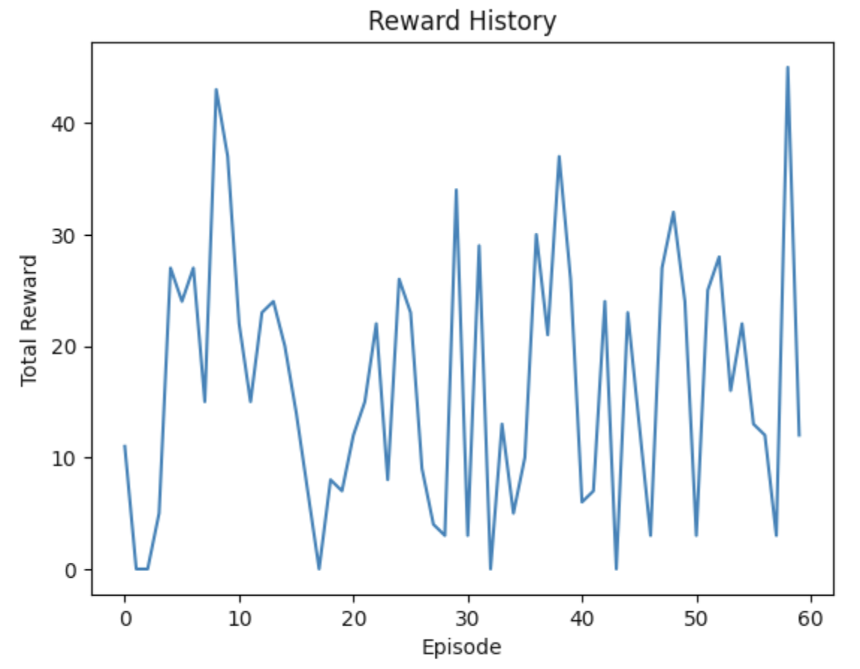
Results
Initial Success:
Episode 0: Promising start with a reward of 11, indicating effective overtaking.
Episode 10: Notable improvement with a reward of 22, suggesting better strategies.
Learning Challenges:
Episodes 18 to 20: Drop in overall reward to 12, indicating encountered challenges.
Mixed Progress: Fluctuations observed - reward increases to 6 at Episode 40, drops to 3 by Episode 50.
Observations:
Active exploration of different strategies.
No consistent evidence of passing 200 cars in any episode.

Slide 10
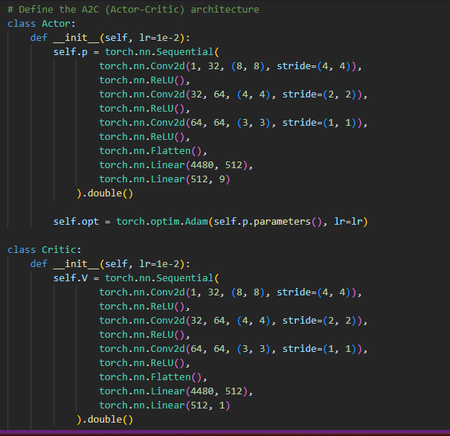
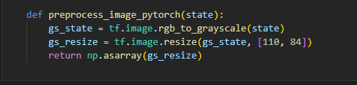
Model Improvement Effort
Separation of Actor and Critic neural networks to alleviate issues with zero or no gradients during backpropagation
Separate Actor loss function and Critic loss function to backpropagate to the gradients separately on each neural network
Modify Critic loss function to be mean of square of difference of predicted value and return
Adopted model architecture design of Mnih et al. (2015)
Preprocess images to reduce computational costs of training on images

Slide 11
Conclusion
Experiment Summary:
Trained agent for 60 episodes in Atari Enduro Racing using Actor-Critic.
Actions guided by observations and rewards.
Learning Outcomes:
Early success in adapting strategies.
Subsequent episodes showed mixed progress.
Future Steps:
Address challenges, fine-tune parameters, or extend training.
Explore effective strategies and refine the Actor-Critic model.

Slide 12

Questions
Thank you.

